Slide 1
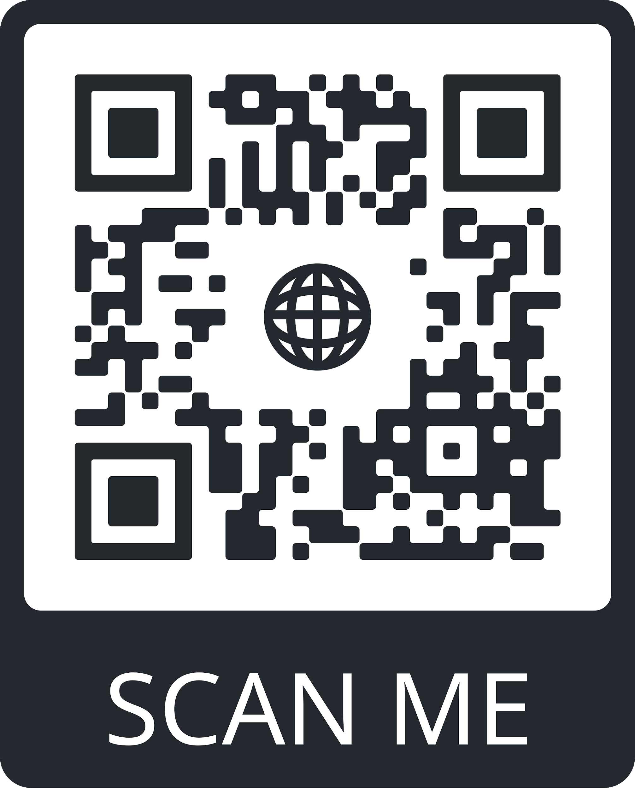
OSIRIS PROJECT
Fernan Enrique Cetina Escalante
Jorge Teodoro Dawn Rodriguez
Rodrigo Alejandro Castrejón Cervantes
Cinthia January Huchin Pedrero
Ricardo Reyes Balam Cupul

Slide 2
APPLICATION DEFINITION

Slide 3
OBJECTIVE:
SATURN
Our project intends to help students manage their time, keep track of their future activities and allow them to retrieve time missed. For this purpose, we will develop a tool that allows its users to add and remove objectives. It will also have several options to keep track of them with constant notifications, progress updates and a tool that helps them find a path to complete those activities they missed without overlapping with new tasks.
Saturn is composed of hydrogen and helium

Slide 4
USERS
Primary
Secondary
Potential
Students of 1st semester of UADY studying Software Engineering.
Students of higher semesters of UADY studying Software Engineering.
All students at University level that struggle with time management
Customers?

Slide 5
INNOVATION
“First product to propose a new way in which students can improve their organization by tracking their activities”
“Organization by tracking their activities step by step and having reminders that will suggest new dates for continuing their activities and show their advance”
“We take part by proposing a product to give these methods a boost and help students move forward on their academic commitments.”

Slide 6
REQUIREMENTS

Slide 7
MAIN REQUIREMENTS
Functional requirements describe what the system should do.
In order to achieve our mvp we have selected the following requirements:
The user should be able to add, update and remove tasks.
The system should display all of the user’s tasks in a list
Resulting artifacts
When the user has active tasks, the system shall keep pushing notifications until they complete them.
Each task should display its progress on the task view.

Slide 8
The system should display all of the user’s tasks in a list
The user should be able to add, update and remove tasks.
Specific
Easy to verify
It should always appear on the first use and be accessible at any time.
These actions should be accessible via a simple button in the task view.
Each task should display its progress on the task view.
When the user has active tasks, the system shall keep pushing notifications until they complete them.
The tasks should be displayed in an organized manner, either by recently added or by most recent progress.
The notifications should only be ONE sentence long.
The system should only be able to send ONE notification per day.

Slide 9
PRIORITIZATION: MoSCoW
Must have
Critical to the delivery of the current Sprint.
Should have
Important but not necessary for the increment delivery
Could have
Desirable requirements that could improve the user experience.
Won’t have
Lowest-payback requirements that have been agreed not to be planned for the time being.

Slide 10
MoSCoW IN ACTION...
We repeat this process for each requirement...
REQUIREMENT
Display all of the user’s tasks in a list
This requirement is necessary for our project’s functionality
OBSERVATION
DIFFICULTY
Easy to implement
CLASSIFICATION
M: Must have

Slide 11
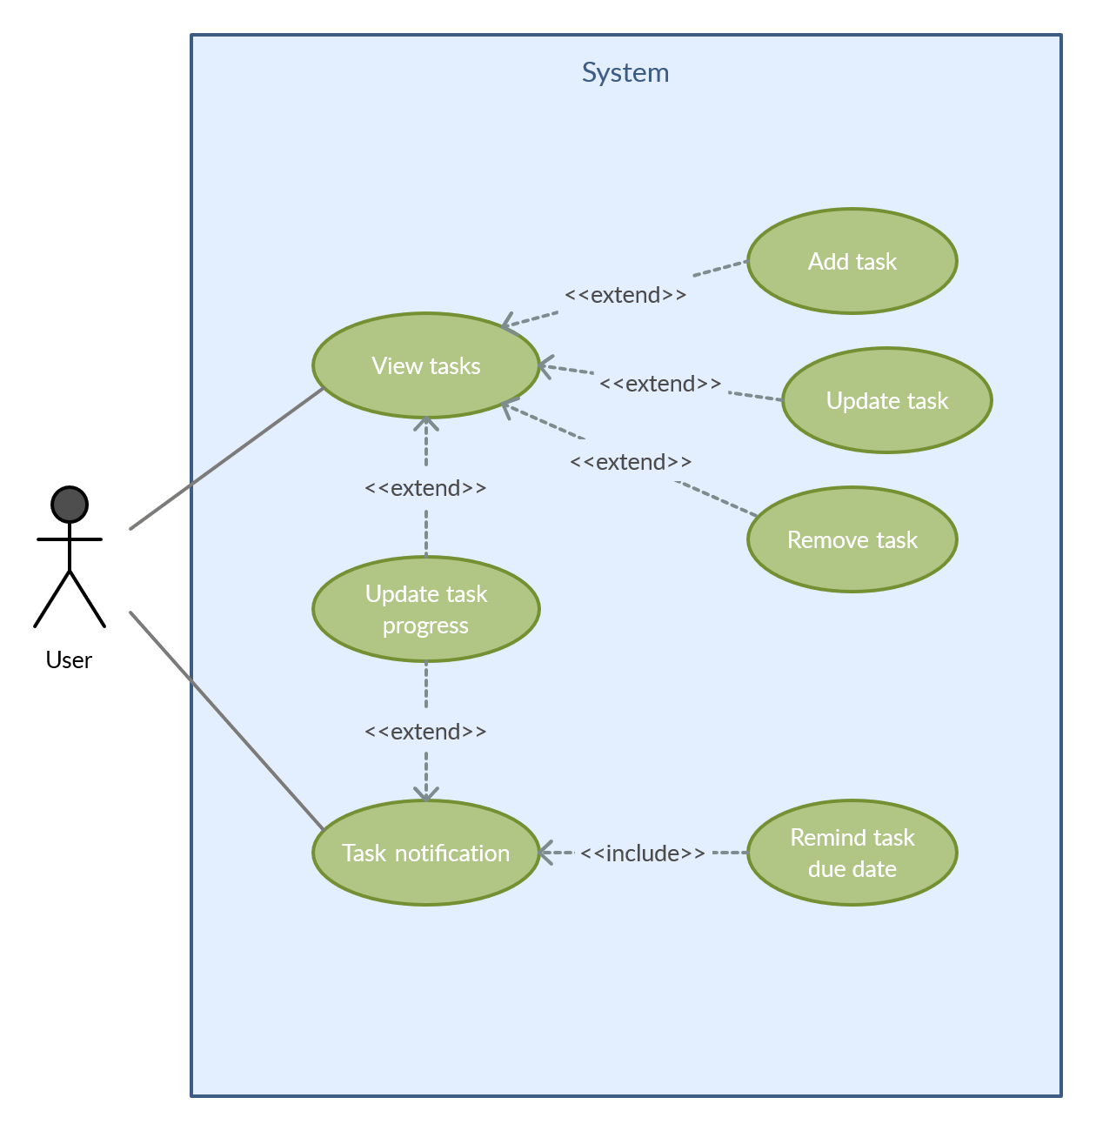
USE CASES
TASK ACTIONS
USER
SYSTEM
REMINDERS
These actions can be performed via the tasks list view.
The user has direct access to the tasks list.
The system keeps pushing notifications to the user.
Task reminders rely on notifications in order to work.

Slide 12
Development process

Slide 13
Methodology
We are implementing scrum due to its flexibility and its ability to adapt to the project. We have already determined the product backlog that covers the needs of our users, which we identified based on a survey that 25 of our classmates answered.

Slide 14
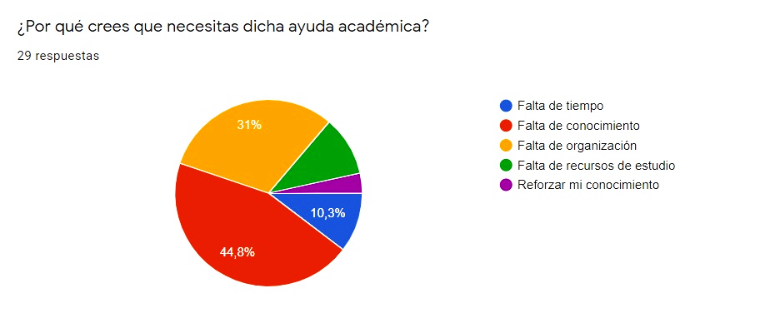
Methodology

Slide 15
Scrum master.
Developers.
Developers.
ROLES
Fernan Enrique Cetina Escalante
Jorge Teodoro Dawn Rodriguez
Rodrigo Alejandro Castrejón Cervantes
Cinthia January Huchin Pedrero
Ricardo Reyes Balam Cupul

Slide 16
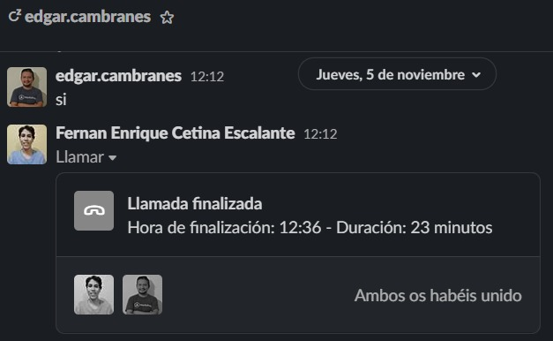
Evidence of meetings
To keep track of the progress of the activities and maintain communication between the team members, we hold review meetings once a week or every 15 days, depending on the needs of the group.
October / 22 / 2020 - November / 23 / 2020

Slide 17
Process description.
Defined responsibilities:
The assignment of activities are done according to the knowledge of each member. Each activity is carried out in subgroups, ie the main activity is divided into one or more sprints, which in turn is shared by two or more team members.

Slide 18



Process management.
Activities
The schedule of activities is created for the 3 increments.
The objective and users are well defined.
A calendar of activities is defined in the general panorama with managers and products; the repository is created.
The team meets to define commitments on the products that must be shown, tools and methods are also specified.
Objective, users, clients, and innovation are defined.
The agile framework is defined with the description of the process, the management, the evidence of the meetings, and the quality assurance.
Monitoring tools:
Scrum.
Trello.
GitHub.
Excel

Slide 19
Tasks of some agile methodology.
Update the repository.
Assignment of the activities in the trello.
Update of excel document.
Making changes.
Mark the contribution of each participant.
Move the tokens of the performed activities.
Creation of new branches.
Create the general sheets of the pending work.
Assignment of new tasks and their managers, as well as the delivery date.
Description update.

Slide 20
Quality check:
For an activity, process or product to be delivered, we monitor the process that was carried out, then we submit the final product to a series of reviews. When we find an issue, the product in question is returned and it is assigned to the corresponding developer so that they can apply their corrections. At the end of this process, it is evaluated one more time by the scrum master and by all the members.

Slide 21
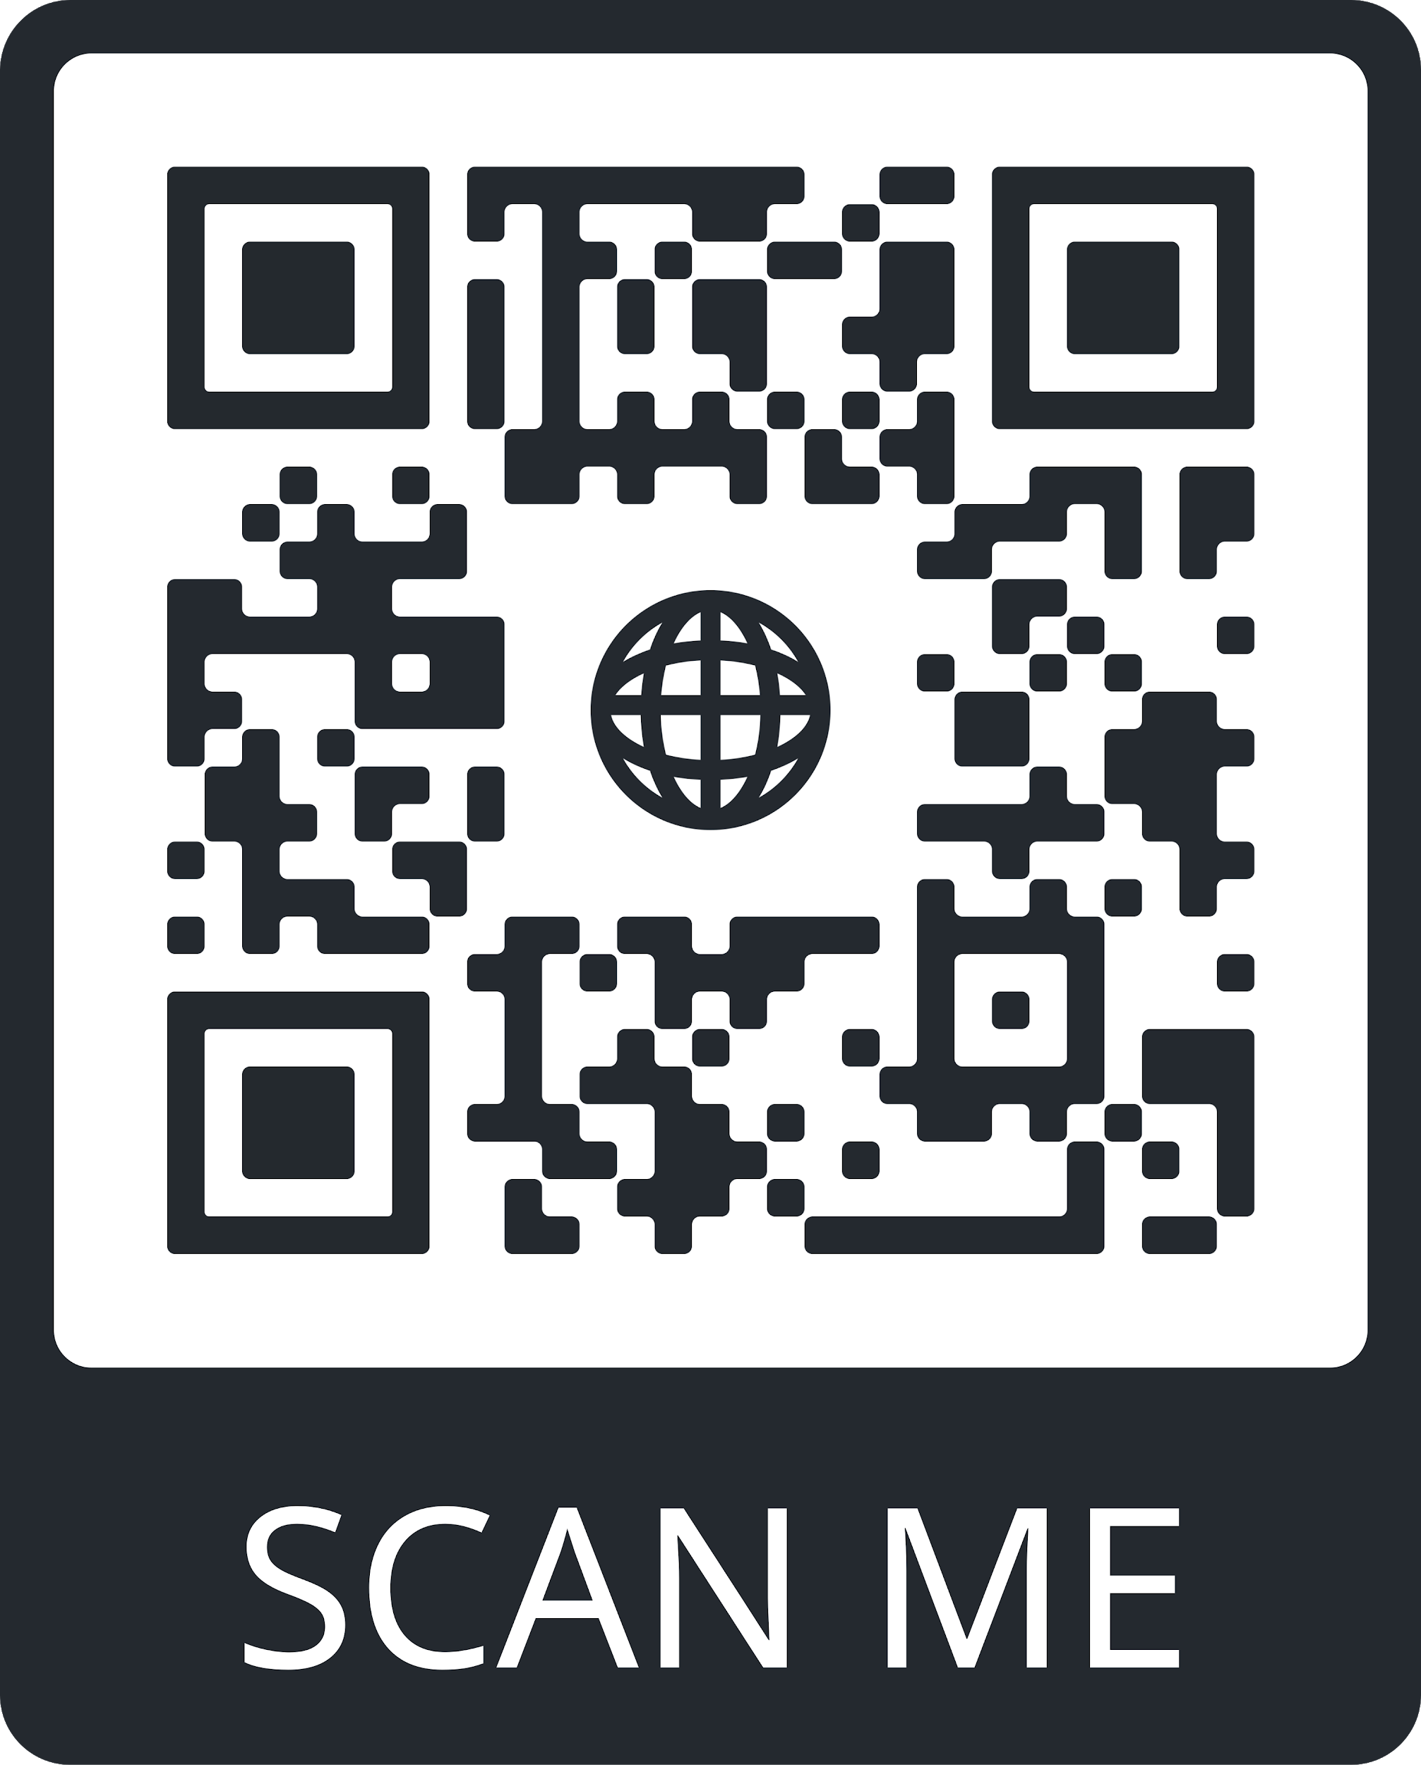
CHECK OUT OUR PROGRESS!
Github repository
Detailed first increment document

Slide 22
THANKS

